Slide 1
HotRest (Waiter-less Hotel and Restaurant Management System)
By:
S.M.Humraan (15k-2882)
Aleem Zulfiqar (15k-2847)
Azeem Khalid (15k-2845)

Slide 2
What is HotRest???
HotRest is a front-desk hotel management software designed typically for billing, online food ordering and database management of guests checking in and out of the hotel and restaurants.

Slide 3
Why we need HotRest???
Our aim is to reduce the workforce of company which would benefits the company financially.
It would be a waiter less Hotel and Restaurant in which the orders would be placed online which would benefit the customer from the hectic situations.

Slide 4
Features
Some of the main Features of Include:
Waiter less management
Less workforce to earn more profit.
Online food ordering
Reducing waiting time of customers.
Online Hotel room reservations
Avoiding the confusion for room reservations
Food Delivery
Providing door to door delivery services.
Admin Panel
Separate admin panels.
Estimated time for dine-in
Keeping the customers updated of their dine-in food timings.

Slide 5
Features
Updates for customers
Emailing customers about their charges.
Special rewards for Loyal customers
Providing special discounts to our loyal customers.
Facebook Page
Providing daily updates about our products and services.
Pick and drop services
Providing pick and drop services to customer from airport to hotel.
Online Check-inn
Checking inn and out through our mobile.

Slide 6
Work Completed

Slide 7
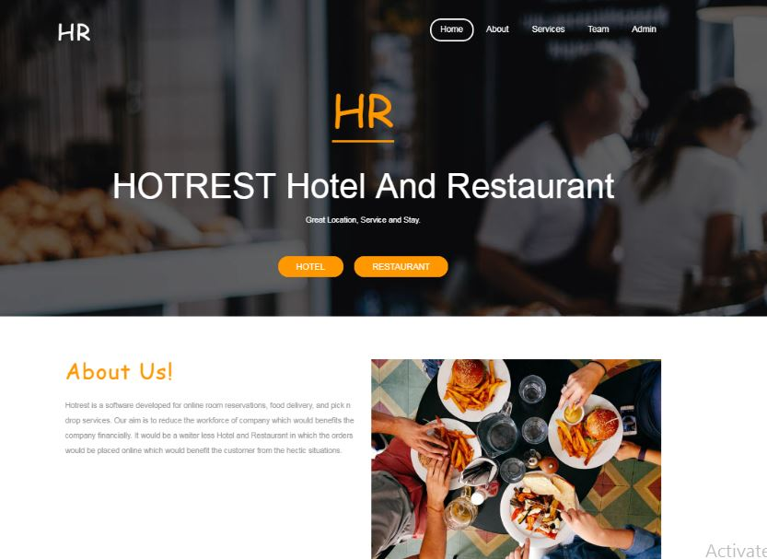
Main Page

Slide 8
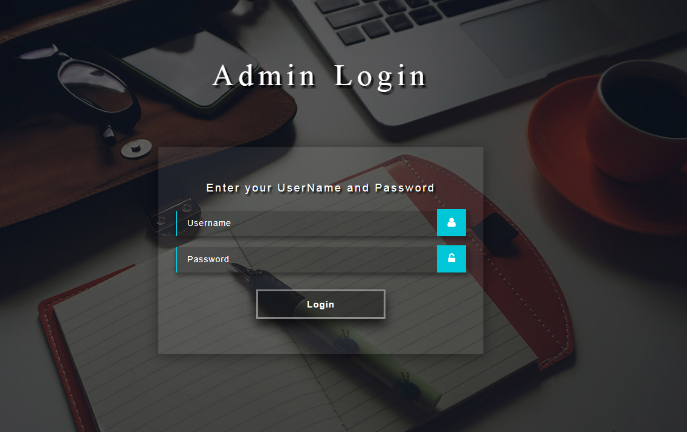
Admin Page

Slide 9
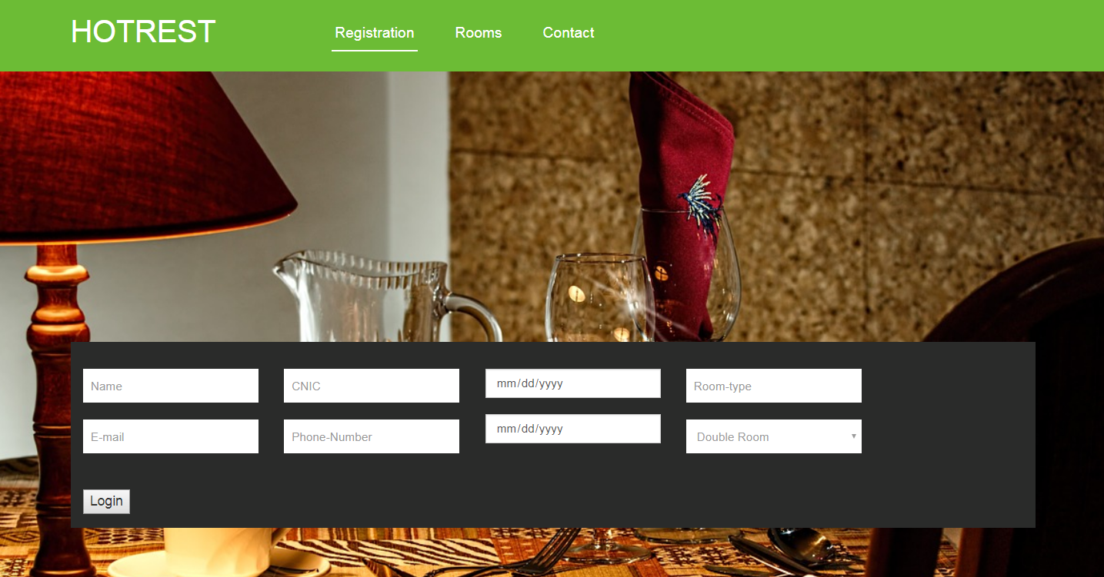
Hotel Page

Slide 10
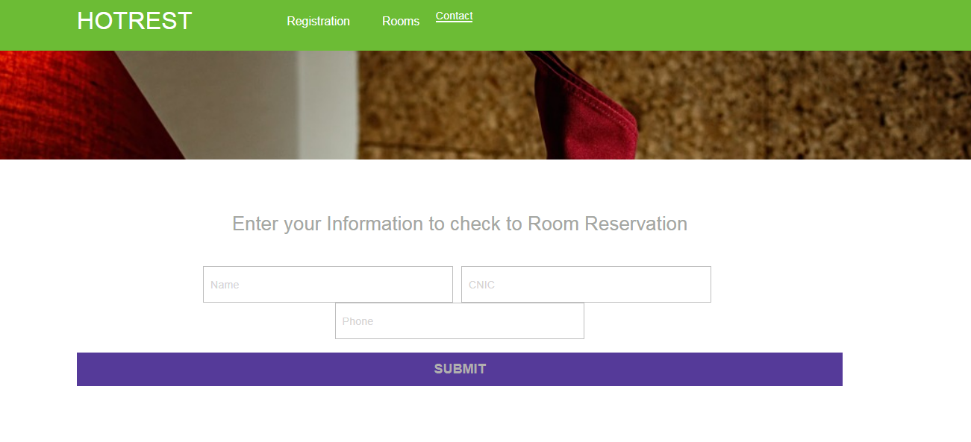
Hotel Room Confirmation Page

Slide 11
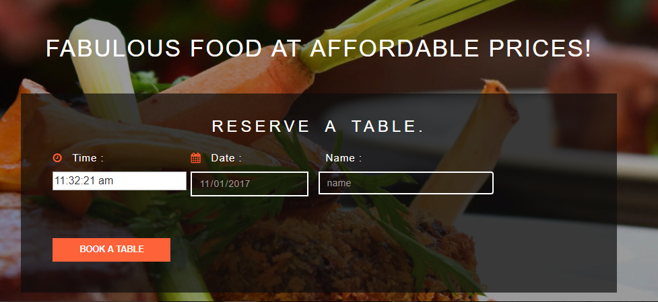
Food Ordering Page

Slide 12
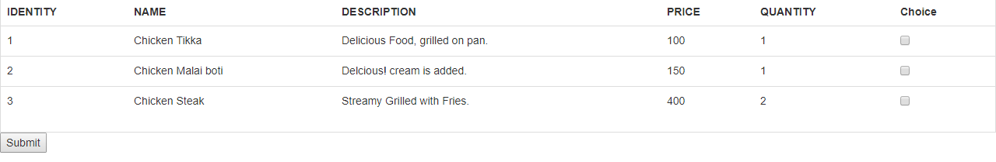
Menu list (In Progress)

Slide 13
Backend

Slide 14
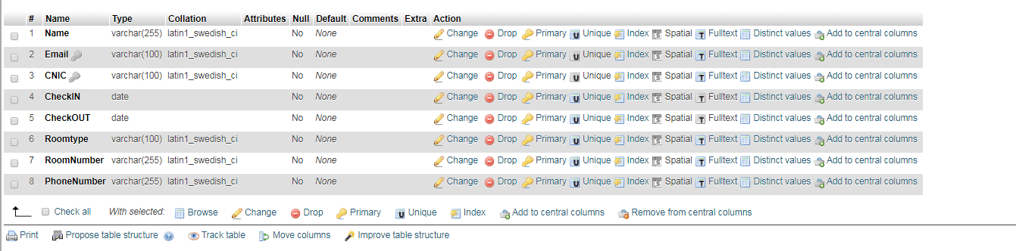
Customer DataBase

Slide 15
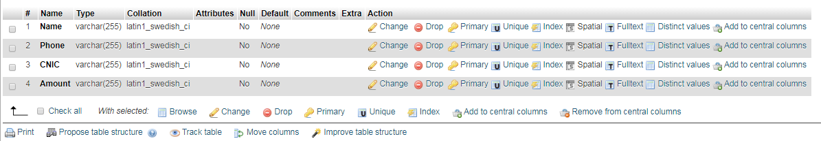
Billing DataBase

Slide 16
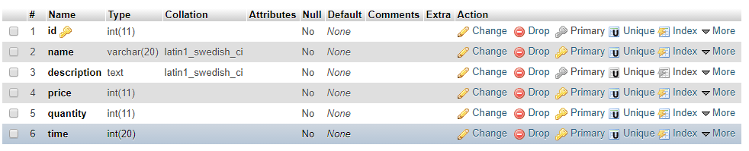
Food Details DataBase

Slide 17
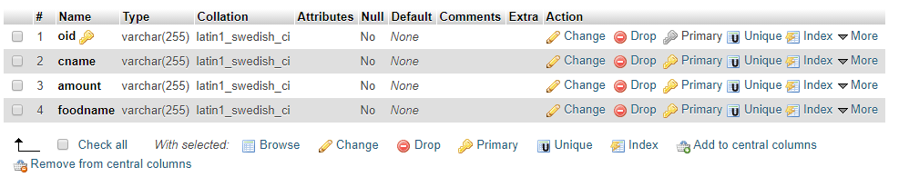
Food Order DataBase

Slide 18
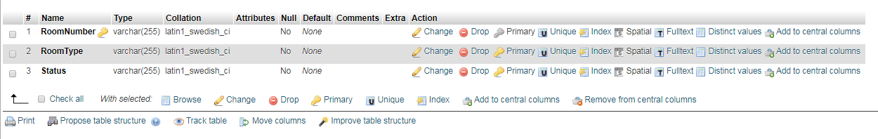
Room Reservation DataBase

Slide 19
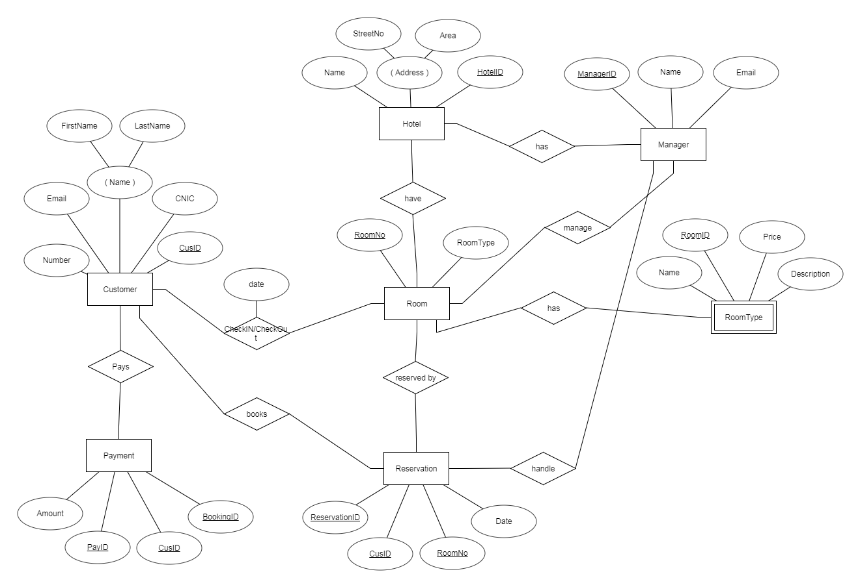
Hotel ERD

Slide 20
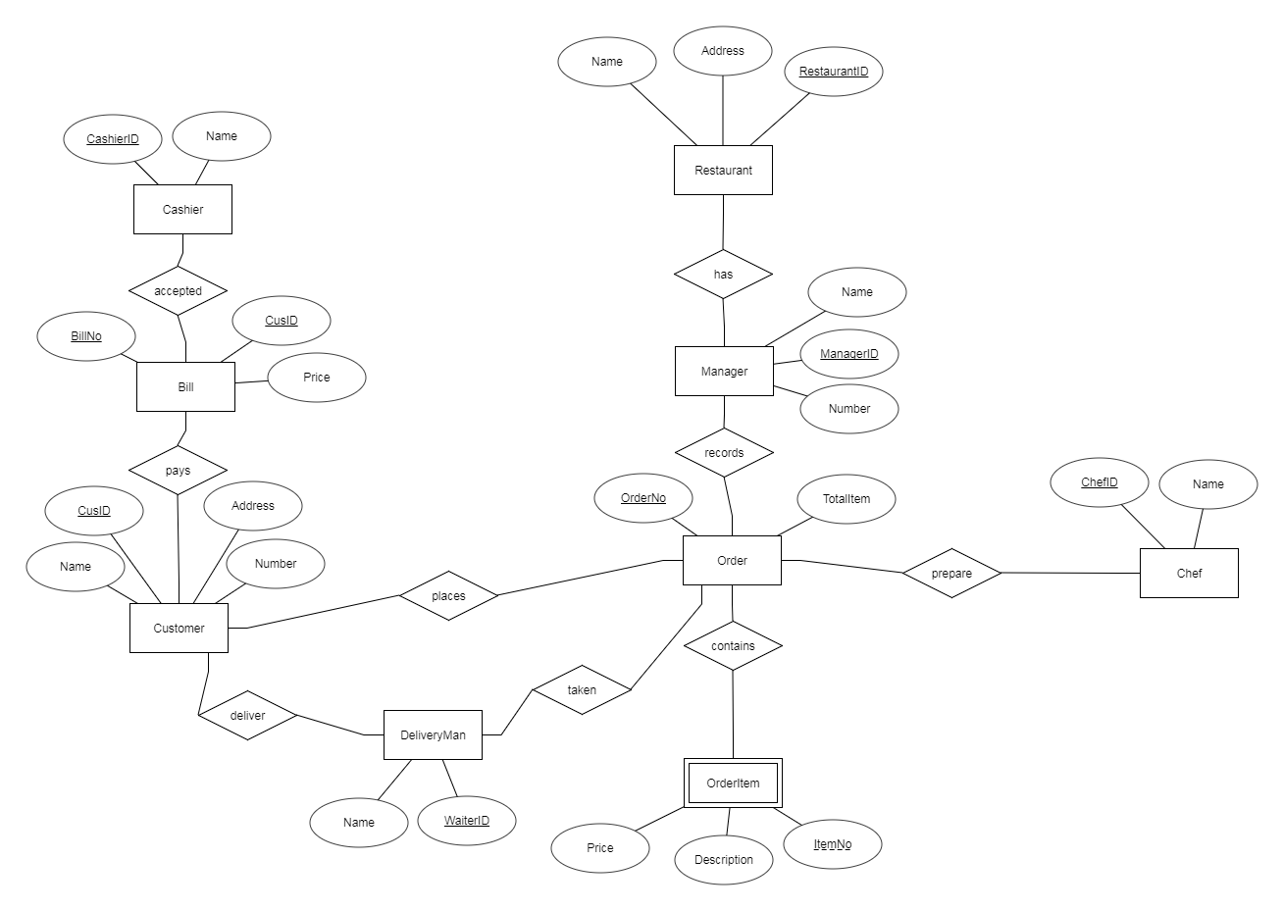
Restaurant ERD

Slide 21
Work Remaining

Slide 22
Milestones to be achieved
Online Room Reservation
Online Food Ordering
Waiter-less Management
Estimated time for Dine-in
Notifications for Customer
Pick and Drop Services
Food Delivery
Admin Panel

Slide 23
Documentation
Project Proposal (Done)
SRS (Done)
SDS (Done)
Progress Report (Done)

Slide 24
Work Distribution
Equally distributed among all group members.

Slide 25
Thank You!!!

Slide 26
Any Questions???

